Slide 1
Electronic Structure Theory

Slide 2
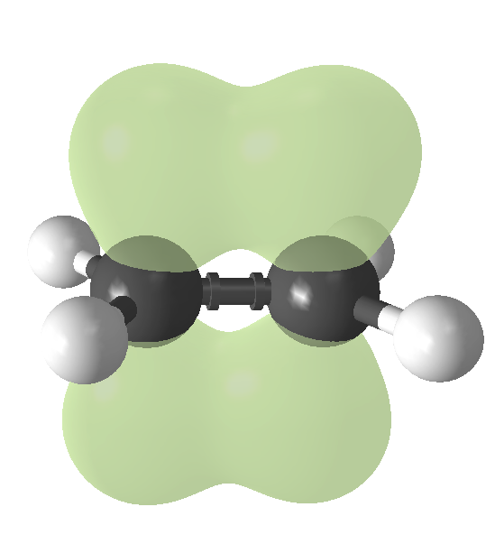
What is Electronic Structure Theory
Determination of location and structure of electrons within a molecule
σ*
1s
1s
σ

Slide 3
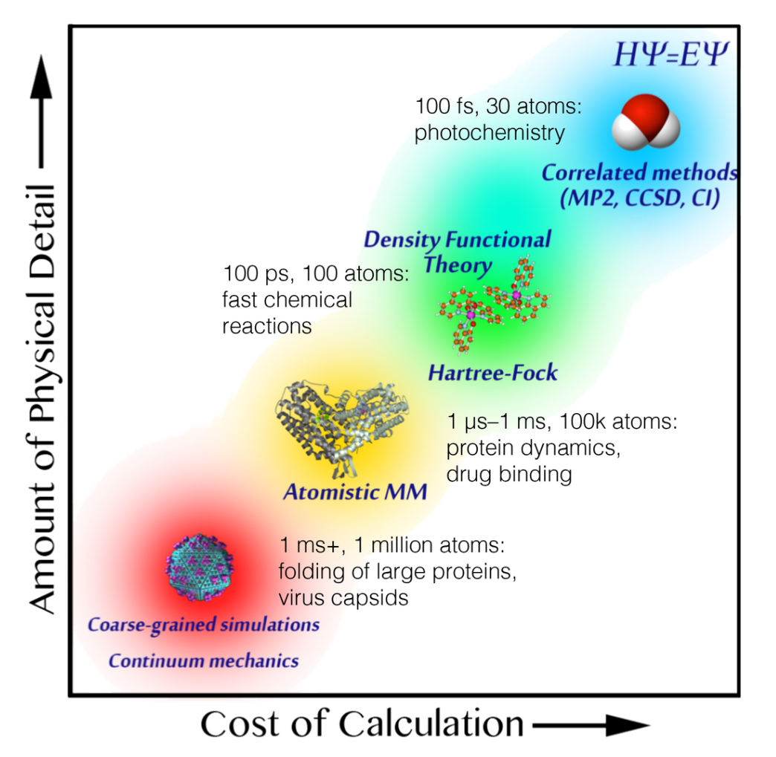
Quantum vs. Classical Calculations
The model you choose depends on what you want to calculate
“All models are wrong, some are useful”

Slide 4
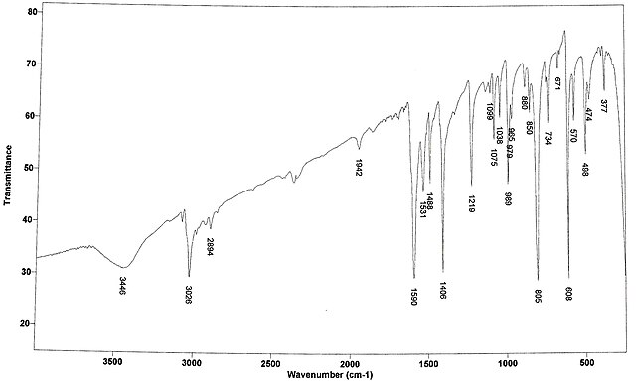
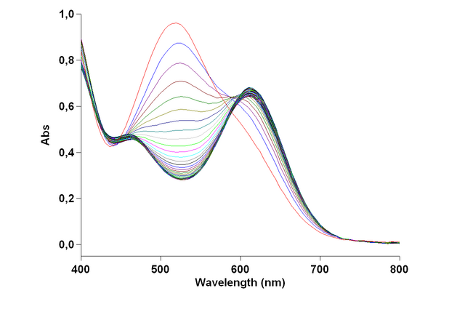
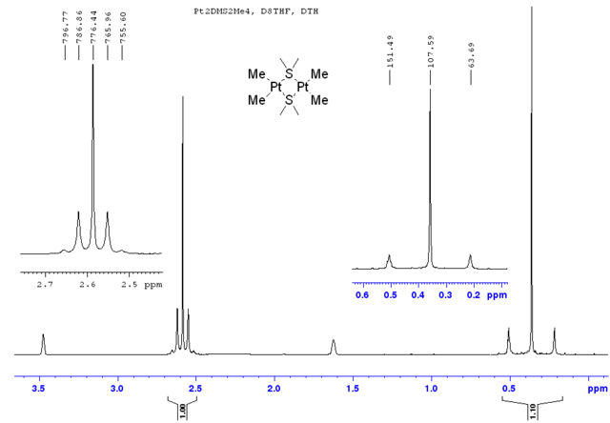
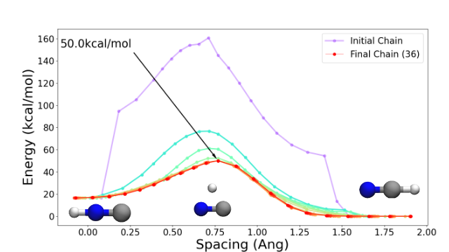
Singlepoint Calculations
Calculation on a single fixed geometry
Electronic properties:
UV/Vis, IR, CD spectra
NMR/Magnetic susceptibility
Bonding information
Reaction energies/Transition states

Slide 5
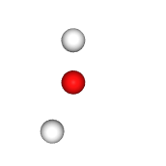

Geometry Optimization
O 0.0000 0.0000 0.0000
H 0.0000 1.5875 0.0000
H 0.7938 -1.8521 0.0000
O -0.1282 -0.1662 0.0000
H 0.3142 0.6933 0.0000
H 0.7087 -0.7918 0.0000

Slide 6
QM Model Selection
Molecular Orbitals (MOs) are expanded in the basis of Atomic Orbitals (AOs). These AOs are defined by your basis set
Your method defines how you are calculating those MOs (what approximations)
Combined, these are referred to as your model, model chemistry, or level of theory
Often written together with a slash, with the method first
Method (Hartree-Fock)
hf/sto-3g
b3lyp/6-31g*
pbe0/def2-SVP
ccsd(t)/aug-cc-pvdz
Basis set (Slater type orbital fit with 3 gaussians)

Slide 7
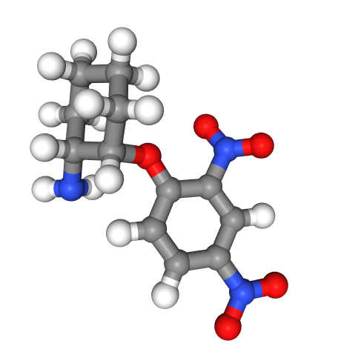
Why not use QM for everything?
Geometry optimization of this molecule took 7 hours on two cores (psi4, ωB97x/6-31G*)

Slide 8
Method Hierarchy
There is a zoo of methods, all with their strengths and weaknesses
Hartree-Fock (HF) – very basic, but inaccurate relative to others (lacks correlation)
Møller–Plesset perturbation theory (MP2, MPn) – Adds correlation
Coupled Cluster (CCS, CCSD, CCSD(T)) – Very accurate, very expensive
Density Functional Theory (DFT) – Very good balance between accuracy and cost
Walter Kohn – 1998 Nobel Prize in Chemistry for the development of DFT

Slide 9
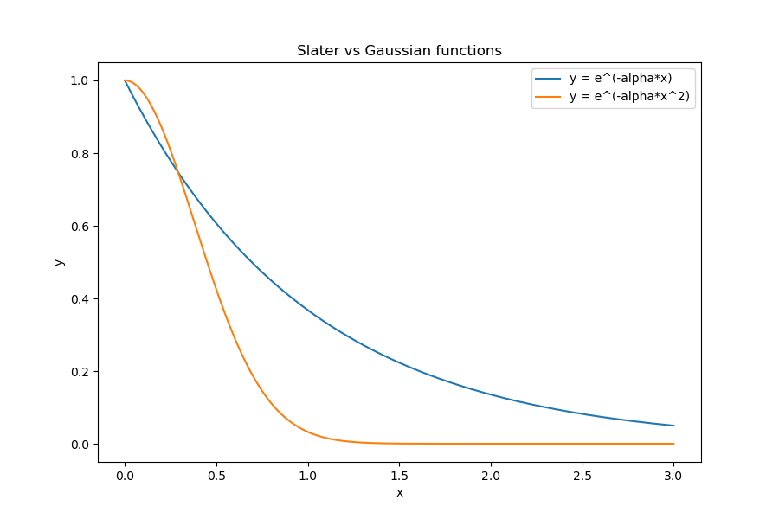
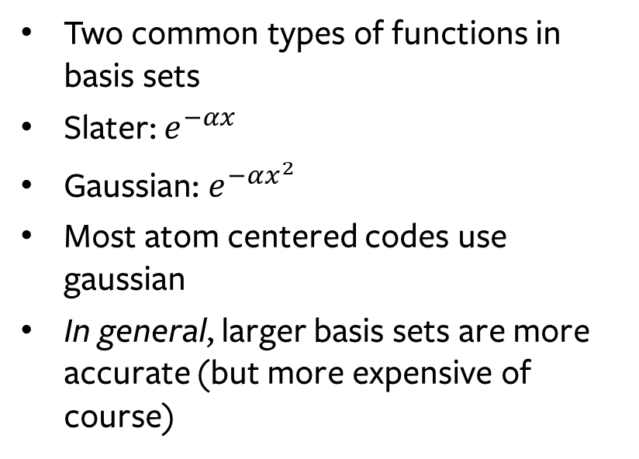
Basis Sets
Two common types of functions in basis sets
Slater: $e^{−αx}$
Gaussian: $e^{−αx^{2}}$
Most atom centered codes use gaussian
In general, larger basis sets are more accurate (but more expensive of course)

Slide 10
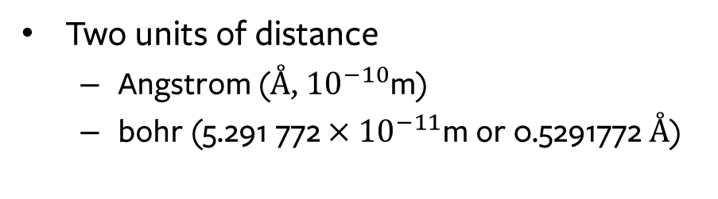
Molecules
In QM, we generally only care about:
Element (number of protons)
Coordinates
Charge & multiplicity (unpaired electrons)
Bonds do not exist in the QM world
Two units of distance
Angstrom (Å, ${10}^{−10}$m)
bohr (${\text{5.291 772}×10}^{−11}$m or 0.5291772 Å)
O 1.548014347149 0.000000000000 0.060071441686
H 0.548241218221 0.000000000000 0.038771425885
H 1.819295099755 0.000000000000 -0.902428819751

Slide 11
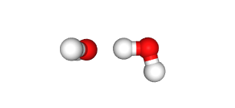
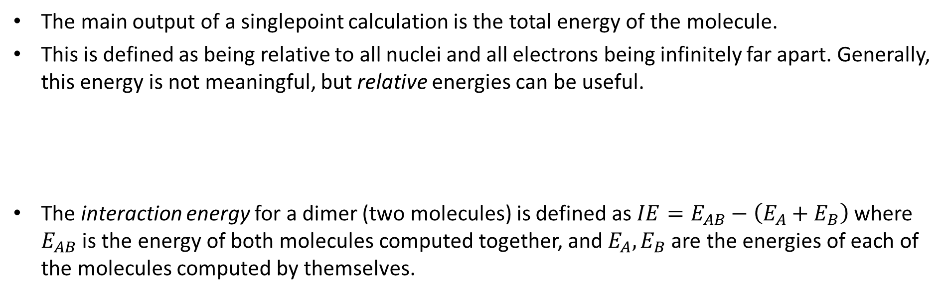
Interaction Energy
The main output of a singlepoint calculation is the total energy of the molecule.
This is defined as being relative to all nuclei and all electrons being infinitely far apart. Generally, this energy is not meaningful, but relative energies can be useful.
The interaction energy for a dimer (two molecules) is defined as $IE=E_{AB}−\left(E_{A}+E_{B}\right)$where $E_{AB}$ is the energy of both molecules computed together, and $E_{A}, E_{B}$ are the energies of each of the molecules computed by themselves.

